Slide 1
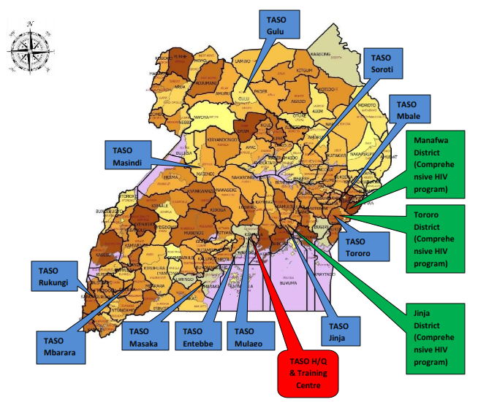
A Differentiated ART Delivery Model for Female Sex Workers in Uganda: Community Client Led ART to improve outcomes
Introduction
Site description
Uganda, HIV prevalence is 6.0% (UPHIA 2017.
Key Populations remain disproportionately affected.
Female Sex Workers (FSW) prevalence 33% (Crane Survey 2009).
Only 16% of the FSW initiated on ART were still retained on ART after roll out of test and treat (TASO program data).
To support improved outcomes, among FSW, TASO Entebbe innovated differentiated ART delivery model for FSW.

Slide 2
Description
Applies both to the clinically stable and unstable clients
Categorized based on stability and geographical area/work location
Joining the group model is voluntary
Group selects own peer leader- Gp # 3-10
Medical review based on clinical stability - monthly for clinically unstable and 6- monthly for the stable

Slide 3
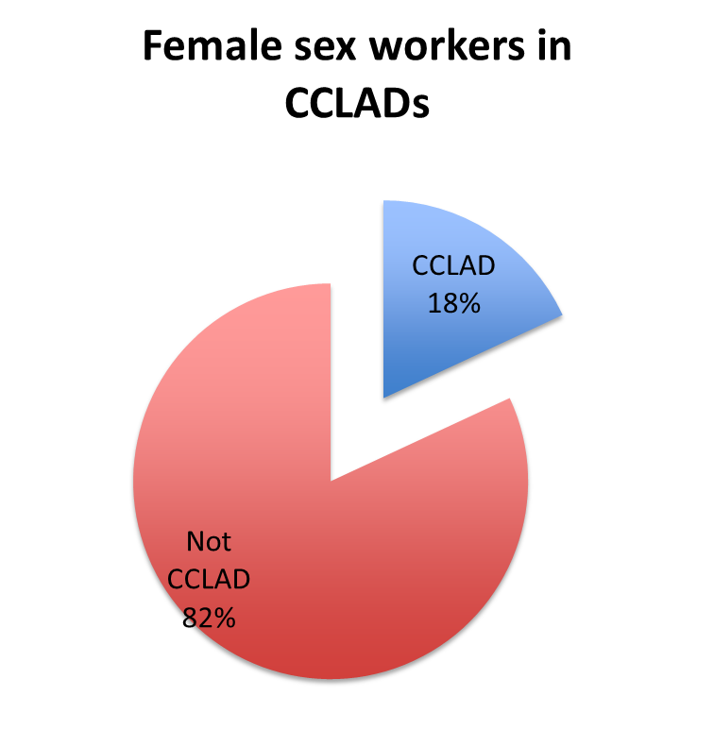
Results and conclusion
Results
The CCLAD model has demonstrated good treatment outcomes among both stable and unstable female sex workers
Clinically unstable key populations can benefit from differentiated service delivery models

